Slide 1
Comparison of
Monolith vs. SOA vs.
Microservices

Slide 2

What you will learn

Slide 3

What is Monolith?
• Has all or most of its functionality
within a single process
• Managed in internal layers for:
• Security
• Reporting
• Analytics
• User interface
• Data access
• Interconnected
• Interdependent

Slide 4

Benefits and drawbacks of Monolith
Benefits:
• Simple
• Less cross-cutting
Drawbacks:
• With growth, complexity
increases
• Less flexibility to adapt to
new technology

Slide 5

Monolith - Example
• Windows Forms Application
User interface
Business Logic
Data Access

Slide 6
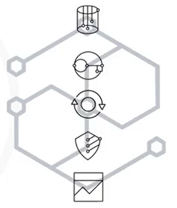
What is SOA?
• Designed and built in a service provider
and consumer approach
• Provides services that are:
• Seamless
• Reusable
• Comprises:
• Interface
• Contract
• Implementation

Slide 7

Benefits and drawbacks of SOA
Benefits:
• Increases reliability
• Supports parallel
development
Drawbacks:
• Complex design
• Expensive investment

Slide 8

SOA - Example
• Banking System
Payments
Governance
Analytics
Accounts

Slide 9
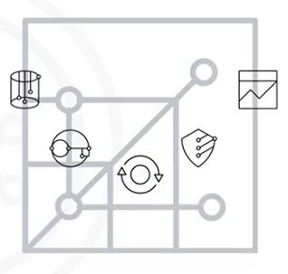
What are Microservices?
• Comprise:
• Loosely coupled
• Reusable
• Specialized independent
components
• Microservice data is not shared
• Scalable
• Technology independent

Slide 10

Benefits and drawbacks of Microservices
Benefits:
• Ease of development
• Flexibility to add new
technology
Drawbacks:
• Security requirement
• Debugging is a challenge

Slide 11
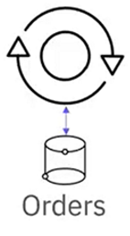


Microservices - ExampLe
• E-commerce

Slide 12
Recap
In this video, you learned that:
• Monolithic design is interconnected and interdependent
• SOA design provides seamless integration and reusability
• Microservices architecture gives you targeted scalability
and flexibility

